Slide 1
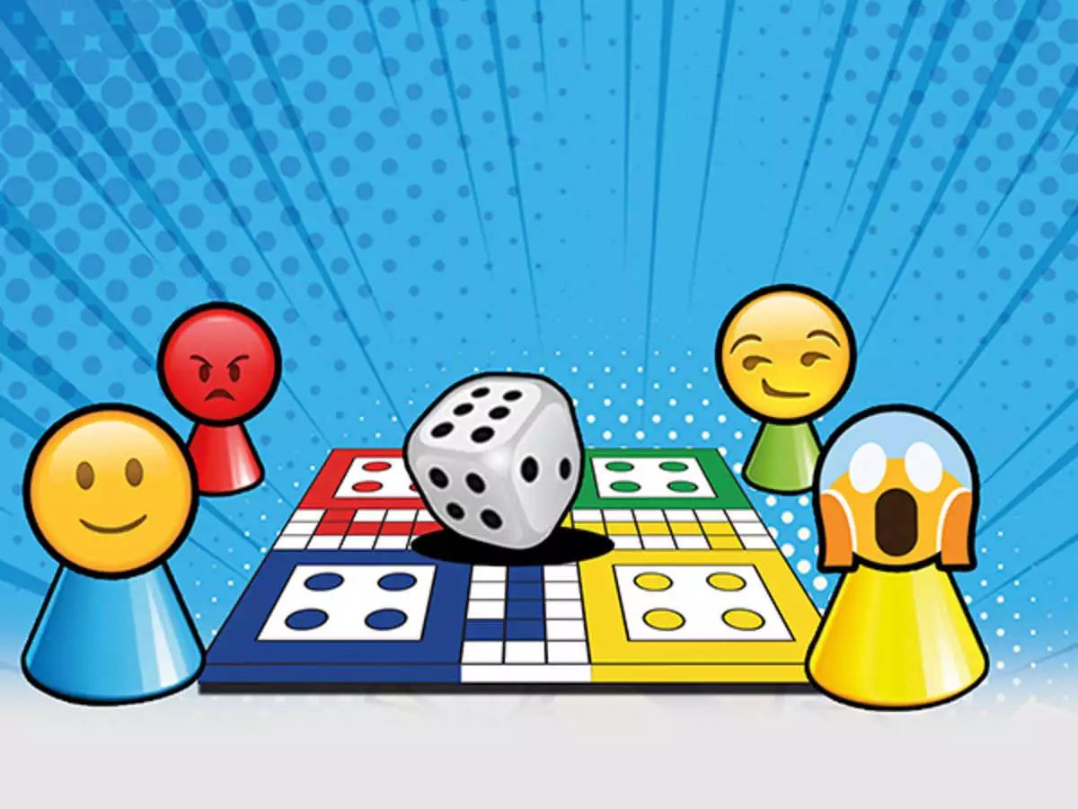
Simple Ludo Game
By Doha Fekouss & James Cridland

Slide 2
Requirements
Ludo is a strategy board game with up to four players where each player races from start to finish, moving according to a dice roll. The aim is to reach center of the board before the other players.
If the player is on a green or yellow space, they are safe otherwise they are unsafe and if another player lands on them, they can kill them and send them back to their initial start position.
The maximum number that can be rolled is 4 and the minimum is 1.

Slide 3
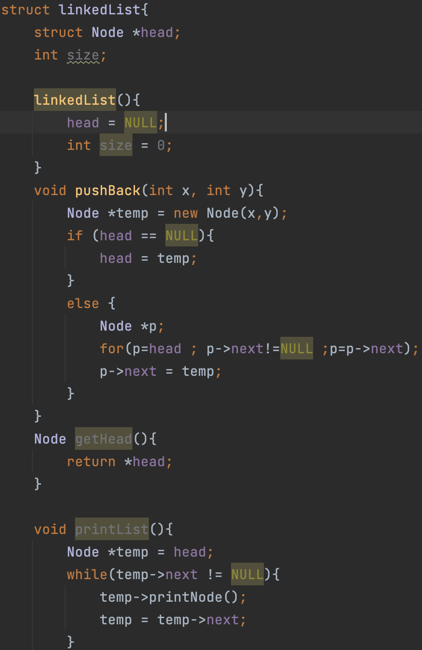
The linked list structure will represent the path each player will take. Each node within the list is represented by an x and y coordinate.
It contains the head which is the player’s initial position as well as a method to return this position.
The pushBack() method adds a new node to the linked list.

Slide 4
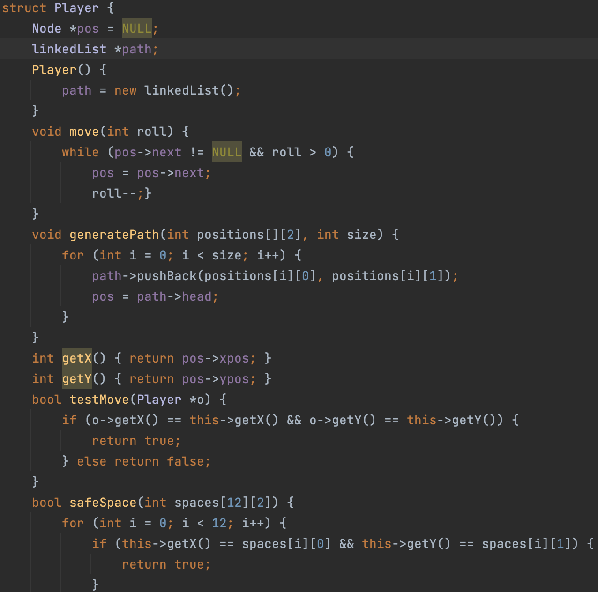
The player structure holds the position of the player and their path.
This structure holds methods to move from one position to the next based on the dice roll and to generate the path for which the player will take.
In addition to this, there are two methods which return a boolean, one used to check if one player lands on another and one to check if player is on a safe space.

Slide 5
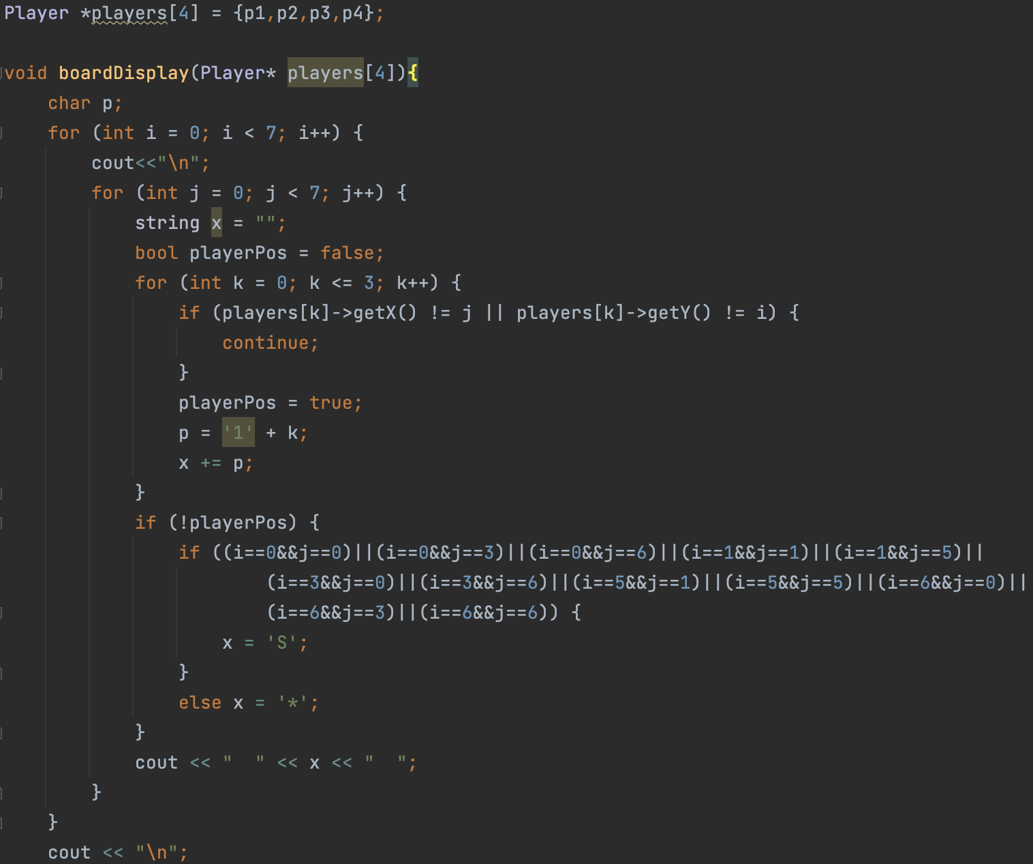
This method creates a 7x7 board where it checks through each position within the board and if one of the players is currently in that position, it prints their corresponding number in place.
It checks if the position is a safe space and prints S accordingly, otherwise it prints * in all other positions.
Positions within the board are represented by coordinates.

Slide 6
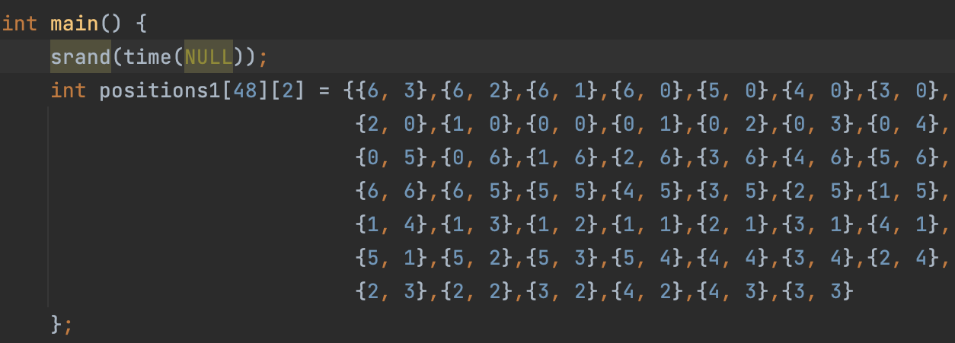
For each player, a 2D integer array was created representing their specific path within the game. Each position is represented by a coordinate. The generatePath() method is called to form a linked list where the next element is the next position on the game board.
The game is played where each player gets a turn to roll the dice and move forward on the game board until three players have reached the final position which is where the game ends.

Slide 7
